Slide 1
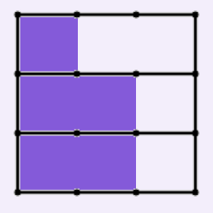
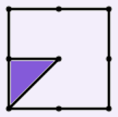
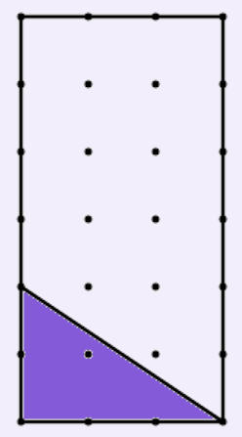




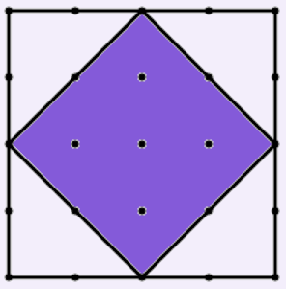
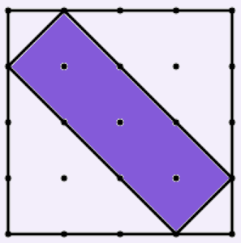
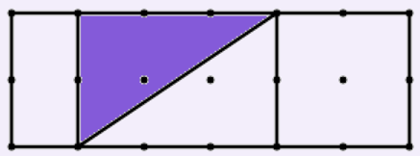
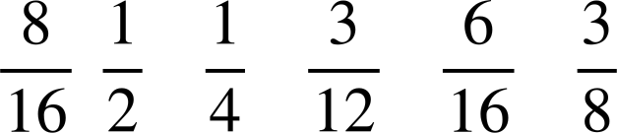
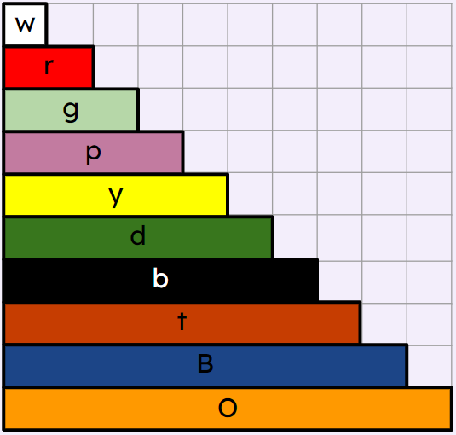



Checking and securing understanding of fractions
Task A: Using fractions to describe diagrams
1) What fraction of each diagram is shaded?
b) c)
or
d) e) f)
or
or
or
2) Work out the missing lengths given that:
t
1
a)
r
?
b)
p
?
c)
y
?

Slide 2


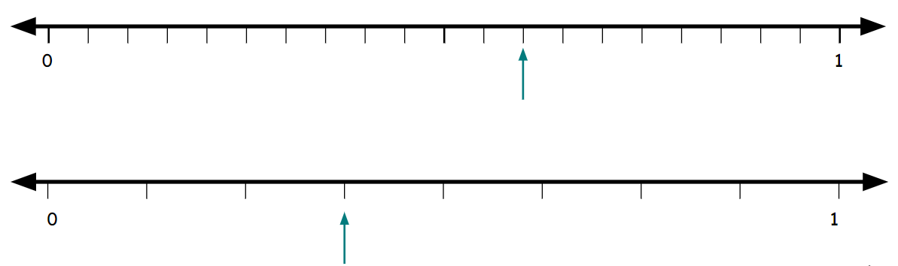


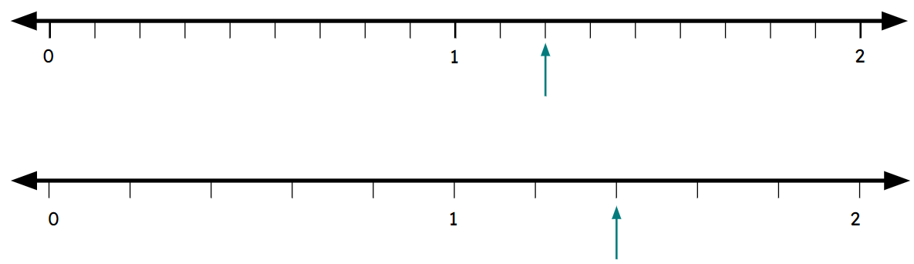



Checking and securing understanding of fractions
3) Work out the missing lengths given that:
O
r
1
a)
d
?
b)
p
?
c)
B
?
Task B: Fractions as numbers on the number line
1) Label the fraction the arrow is pointing to on each number line.
a)
or
b)
c)
or
d)
or

Slide 3
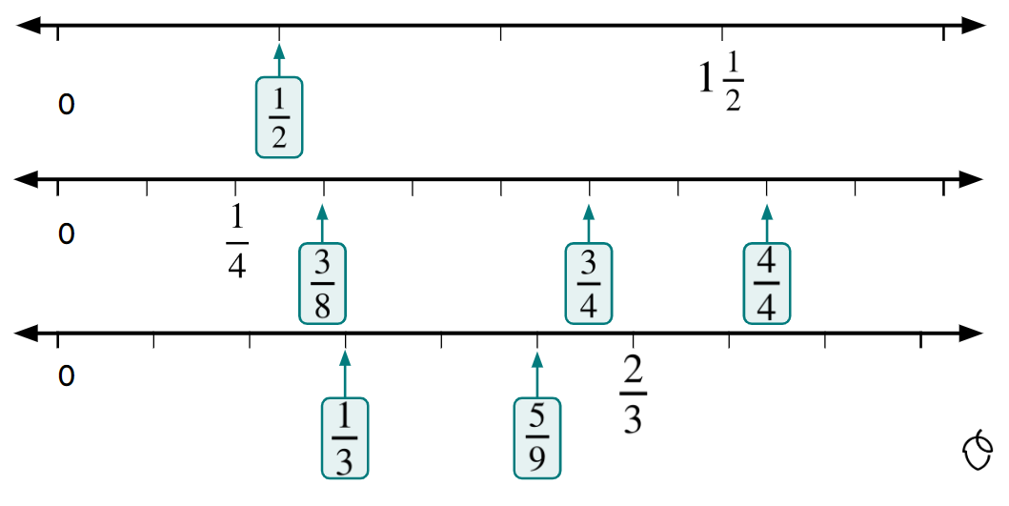
Checking and securing understanding of fractions
2) Fill in the missing numbers on these number lines
Mathematics in Education and Industry
v2.2

